Slide 1
ECE 114 Project Discussion
11/5/2020

Slide 2
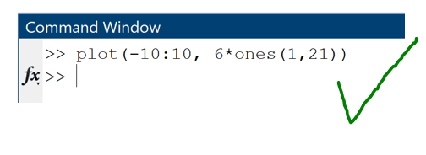
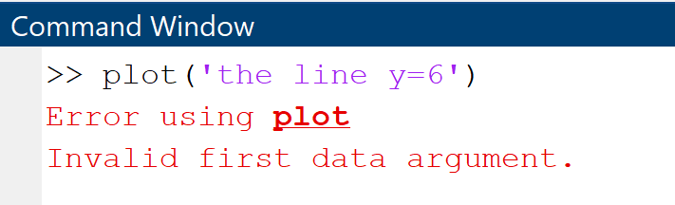
Purpose of Machine Learning
Using only deterministic methods, a computer will only be able to handle inputs that it’s explicitly been designed to handle
This means that the computer will have no ability to handle new situations or deal with cases it hasn’t seen before

Slide 3



Purpose of Machine Learning
A human has the ability to use past experience and process new information. For example,
So you can correctly identify the image. We want computers to learn to do this , too
And you’ve seen people stick out their tongue
You’ve never seen me stick out my tongue at you
But you’ve seen me

Slide 4
Purpose of Machine Learning
We can do this by having the computer:
Match the new input to the closest examples of prior inputs (ex. speech recognition)
Find trends in past examples and extrapolate them to the new example (ex. Recommender systems)
Identify recognizable patterns and relationships in the new input (ex. image recognition/computer vision)
Break the new input into components it’s seen before (ex. text analysis)

Slide 5
Purpose of Machine Learning
Have the computer complete a task that involves making decisions given information
Tasks Like:
Classification: Map an input to a class
Regression: Find a trend in the data
Generation/Synthesis: Create a new samples given past examples, encode and decode data
Enhancement: Make the sample better, remove noise, fill in missing pieces, etc.

Slide 6
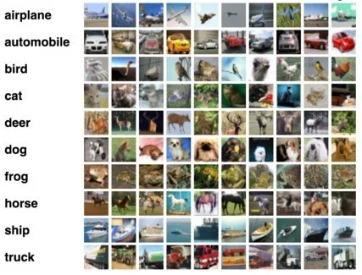
Supervised Classification
Give the machine a large number of samples X together with their corresponding labels y.
Have the machine learn to approximate some mapping function f(X)=y
Test f() on new data

Slide 7

Supervised Classification
For example, which of the following bets would you take? You can take any of them any number of times (as long as you have money):
1. You win (30% chance) I give you $10, I win (70% chance) you give me $1
2. You win (50%), I give you $1, I win (50%), you give me 2$
3. You win (20%), $1,000,000, I win (80%), $100,000
4. You win (99%) , $10, I win (1%), $1,000,000,000

Slide 8
Supervised Classification
Suppose you’d take bets 1 and 3 and reject bets 2 and 4.
We can plot the bets to visualize the criterion that helped us make our decision
We can then tell the computer to automatically accept bets future bets that are more like bets 1 and 3 and reject ones like 2 and 4
This means drawing a curve between the bets that we would accept and those we would reject
f(x)
$$$ you win
Take the deal
3
Reject the deal
$$$ you lose
4
1
2
%chance you win

Slide 9
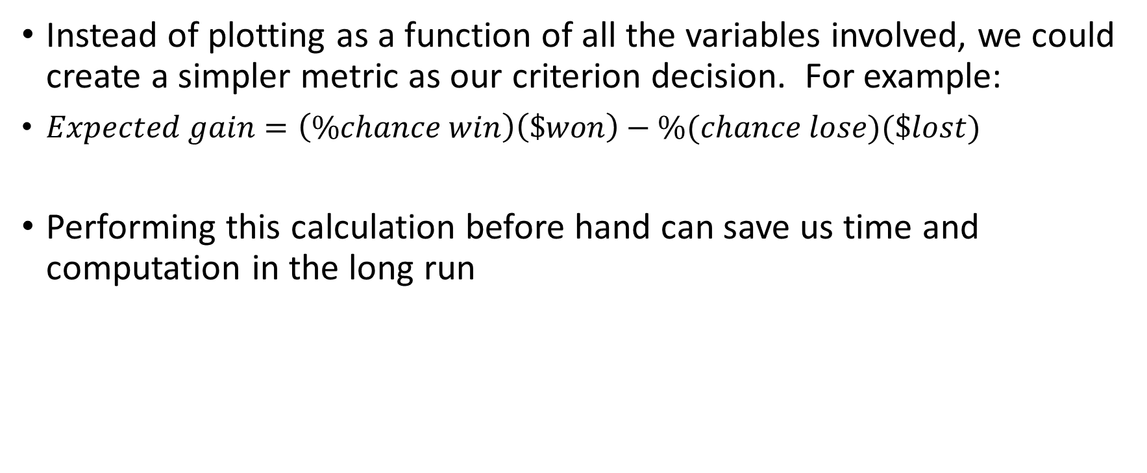
Supervised Classification
Instead of plotting as a function of all the variables involved, we could create a simpler metric as our criterion decision. For example:
$Expected gain=\left(\%chance win\right)\left(\$won\right)−\%(chance lose)(\$lost)$
Performing this calculation before hand can save us time and computation in the long run
f(x)
Reject the deal
Reject the deal
4
2
1
3
Expected gain

Slide 10
Supervised Classification
Then given a new bet, we decide automatically whether to accept or reject it just by looking at where it falls on the graph
Some of the bets used to form the decision boundary could have been outliers. Typically, the more points used to create the decision function, the better. This gives less weight to outliers and edge cases.
f(x)
Reject the deal
Reject the deal
4
2
1
5
3
Expected gain

Slide 11
Data
We use our data to create a decision function
If our data is a collection of signals, we may choose to feed the signals directly into our function as samples
However, if the useful information in the signals is not readily apparent, we may need to preprocess the data to extract the useful characteristics or features from it
We can then feed a vector of these features into the function rather than the whole signal to save time and computational complexity

Slide 12
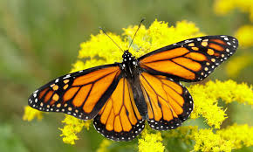
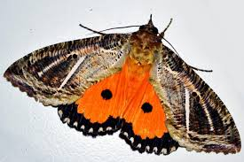
Data
We should choose features that help discriminate between the classes, make sure that the input has information about the output
Example: Choose features to classify pictures as “butterfly” or “moth”
Good features: Antenna shape, wing shape, body shape, fuzziness
Bad features: color, number of legs, position

Slide 13
Mapping and Statistical Inference
What kind of function is f()?
We choose the form of f() and let the machine learn the parameters
Simple function- linear decision boundary: f(x)=mx+b
Let the machine learn the parameters m and b

Slide 14
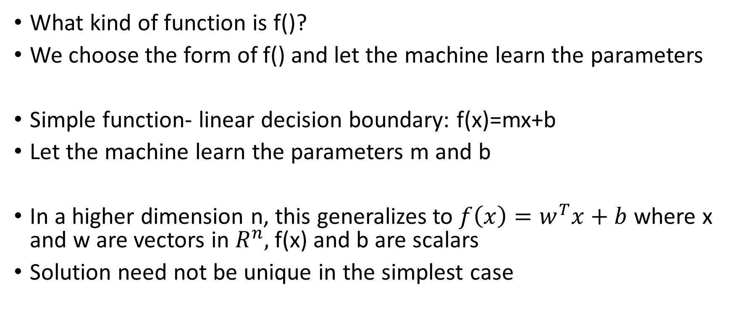
Mapping and Statistical Inference
What kind of function is f()?
We choose the form of f() and let the machine learn the parameters
Simple function- linear decision boundary: f(x)=mx+b
Let the machine learn the parameters m and b
In a higher dimension n, this generalizes to $f\left(x\right)=w^{T}x+b$ where x and w are vectors in $R^{n},$f(x) and b are scalars
Solution need not be unique in the simplest case

Slide 15









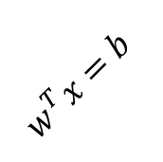


Mapping and Statistical Inference
$f\left(x\right)=w^{T}x+b$ then forms a dividing hyperplane in the space
$w^{T}x=b$
$w^{T}x<b$
$x_{2}=$Wingspan
$w^{T}x>b$
$x_{1}=$Curvature of antenna

Slide 16
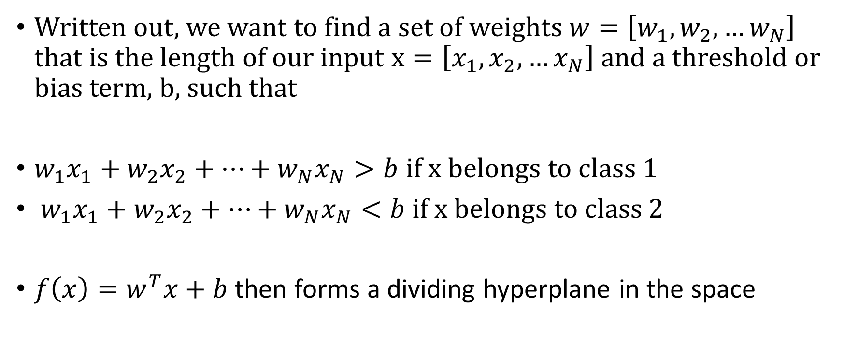
Mapping and Statistical Inference
Written out, we want to find a set of weights $w=\left[w_{1},w_{2}, …w_{N}\right]$ that is the length of our input $x=\left[x_{1},x_{2}, …x_{N}\right]$ and a threshold or bias term, b, such that
$w_{1}x_{1}+w_{2}x_{2}+…+w_{N}x_{N}>b$ if x belongs to class 1
$w_{1}x_{1}+w_{2}x_{2}+…+w_{N}x_{N}<b$ if x belongs to class 2
$f\left(x\right)=w^{T}x+b$ then forms a dividing hyperplane in the space

Slide 17
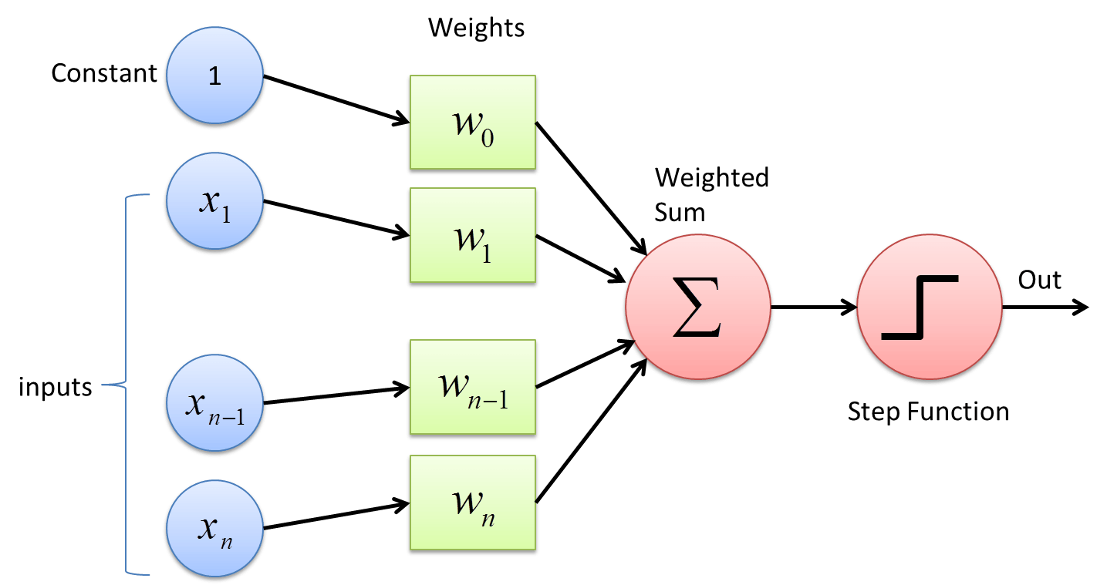

Single Layer Perceptron
We can represent the function $f\left(x\right)=w^{T}x+b$ graphically. We’ll call w the vector of weights and b the bias term. The output is an affine combination of the elements of x. The machine then needs to learn the best weights and bias to form a linear decision boundary for the data
The elements of the data points x are represented by nodes and the elements of the weights w are represented by edges connecting the nodes

Slide 18
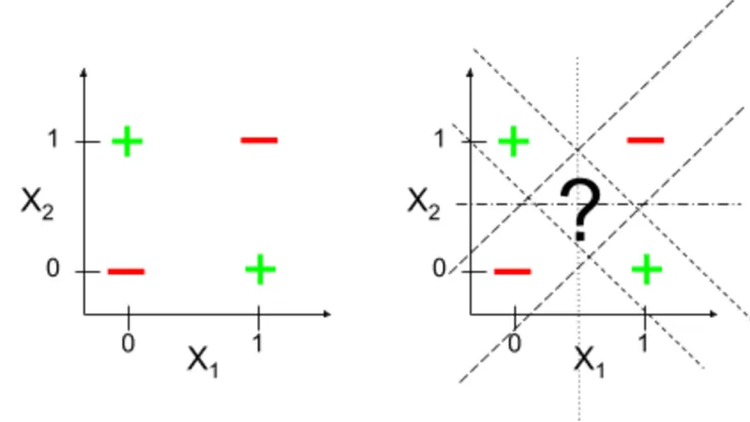
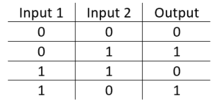
Single Layer Perceptron
This choice of function will not be able to classify data when it is not linearly separable. This is represented in the Xor problem

Slide 19
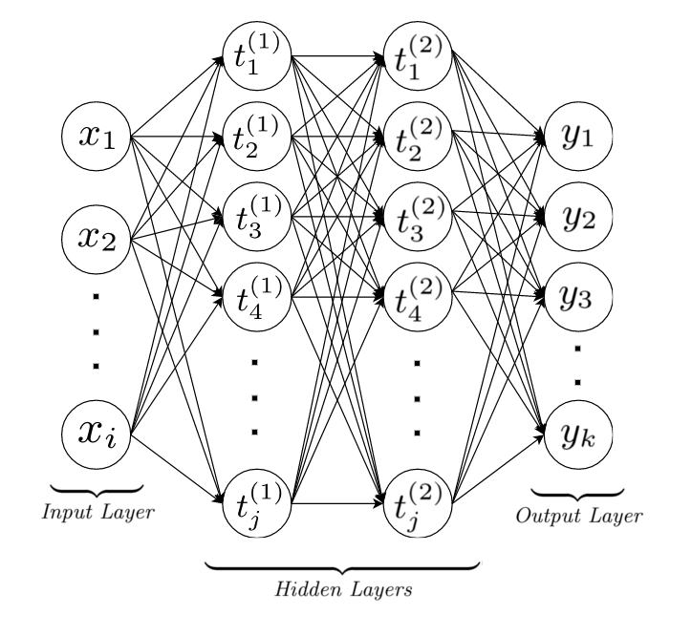
Multi Layer Perceptron
We need a more complicated choice of f(). Let’s try adding more nodes and edges

Slide 20


Multi Layer Perceptron
But wait, this produces an affine combination of affine combinations of x (ie. a composition of affine combinations). A composition of affine combinations can still be written as a single affine combination, so this network doesn’t actually have any more capacity than a single layer
$$A_{2}\left(A_{1}x+b_{1}\right)+b_{2}=A_{C}x+b_{c}$$
Where $A_{C}=A_{2}A_{1}, { b}_{c}=A_{2}b_{1}+b_{2}$

Slide 21
Activation function
If we pass the output of each node through a non-linear function, then we can no longer reduce the network to a single layer. This is called an activation function

Slide 22
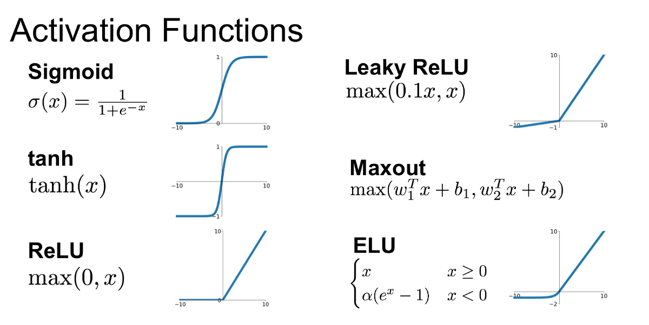
Activation function
There are many choices for this nonlinear function. We should choose based on speed of convergence, differentiability, computational complexity, and other factors useful to us

Slide 23
Multi Layer Perceptron
Our multi-layer perceptron with these nonlinear activation functions now has high enough complexity to learn a function too difficult to compute by hand.
It can learn a complicated decision boundary for our data set
There is one parameter for each node and each arrow. There are several arrows per node. This means that the number of parameters to calculate increases exponentially with the number of layers

Slide 24

Multiclass Classification
If there are multiple classes then we no longer have a 1 dimensional label, y. If there are C classes then y is a vector such that $y∈R^{C}$
We now need a mapping function f(X) that maps X to a vector $y∈R^{C}$
We can then choose X as belonging to the class argmax(f(X))

Slide 25
Loss Function
We want to find the function f() that best separates the data
But what does “best” mean? We have to decide
We give the machine some decision criterion for updating the parameters of f()
We’ll describe this criterion mathematically as a function of the parameters: Loss function L(w,b)
We want to minimize L(w,b) through iteratively choosing (w,b) that minimize it. We will ultimately use the optimal (w,b) that best minimize L(w,b) to create our decision boundary

Slide 26
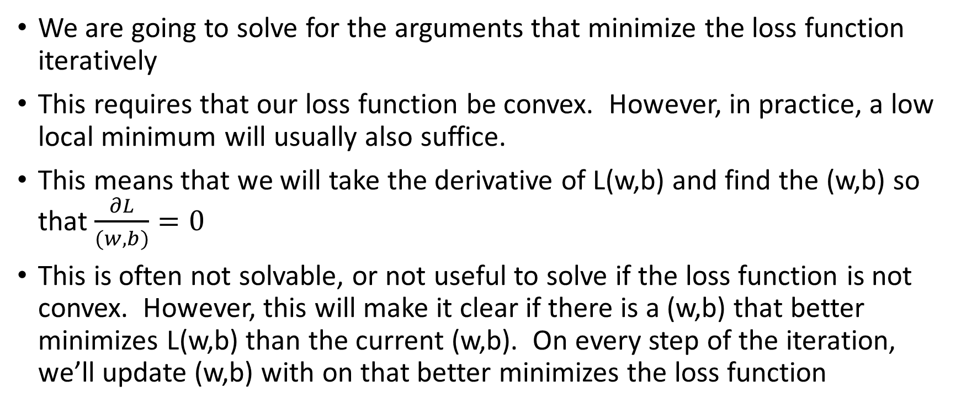
Loss function
We are going to solve for the arguments that minimize the loss function iteratively
This requires that our loss function be convex. However, in practice, a low local minimum will usually also suffice.
This means that we will take the derivative of L(w,b) and find the (w,b) so that $\frac{∂L}{(w,b)}=0$
This is often not solvable, or not useful to solve if the loss function is not convex. However, this will make it clear if there is a (w,b) that better minimizes L(w,b) than the current (w,b). On every step of the iteration, we’ll update (w,b) with on that better minimizes the loss function

Slide 27
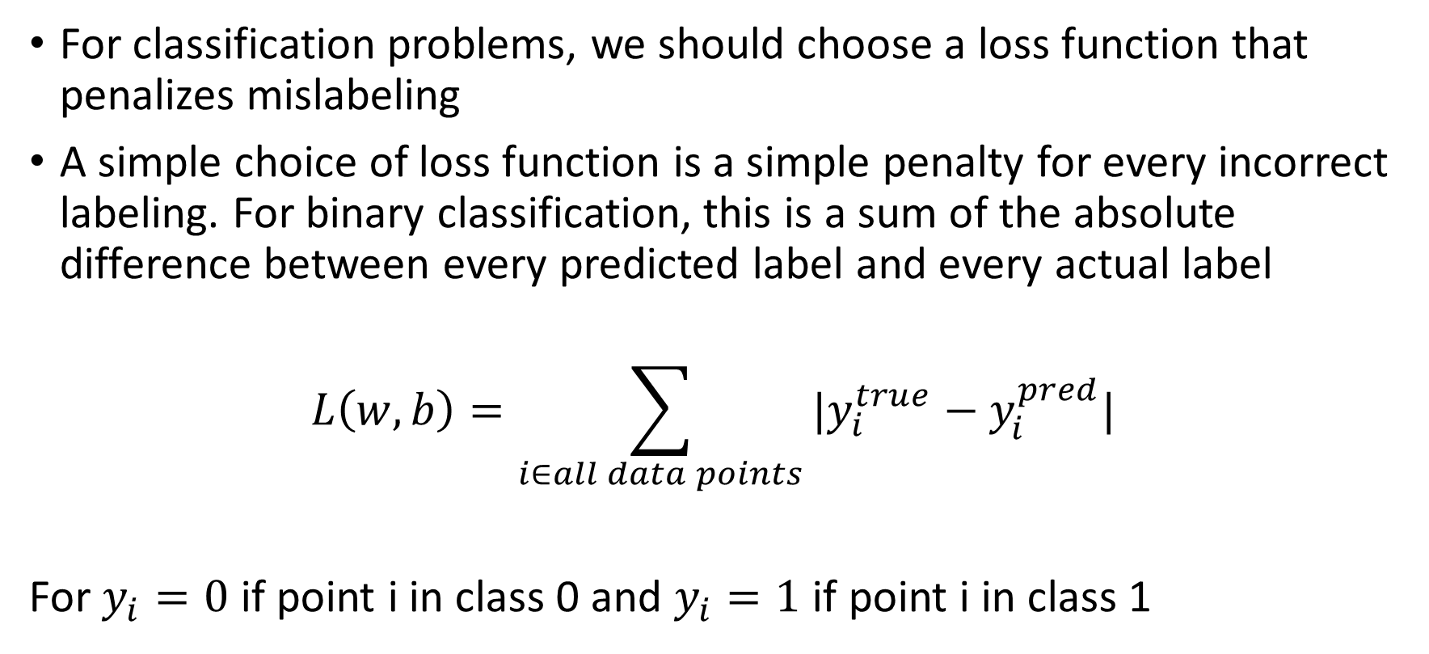
Loss function
For classification problems, we should choose a loss function that penalizes mislabeling
A simple choice of loss function is a simple penalty for every incorrect labeling. For binary classification, this is a sum of the absolute difference between every predicted label and every actual label
$$L\left(w,b\right)=\sum_{i∈all data points}{{|y}_{i}^{true}−y_{i}^{pred}|}$$
For $y_{i}=0$ if point i in class 0 and $y_{i}=1$ if point i in class 1

Slide 28
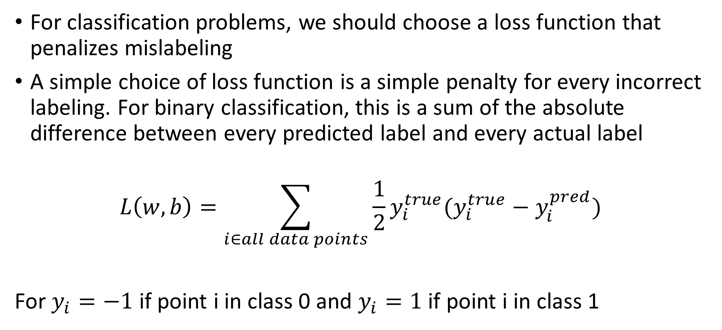
Loss function
For classification problems, we should choose a loss function that penalizes mislabeling
A simple choice of loss function is a simple penalty for every incorrect labeling. For binary classification, this is a sum of the absolute difference between every predicted label and every actual label
$$L\left(w,b\right)=\sum_{i∈all data points}{{{\frac{1}{2}y}_{i}^{true}(y}_{i}^{true}−y_{i}^{pred})}$$
For $y_{i}=−1$ if point i in class 0 and $y_{i}=1$ if point i in class 1

Slide 29
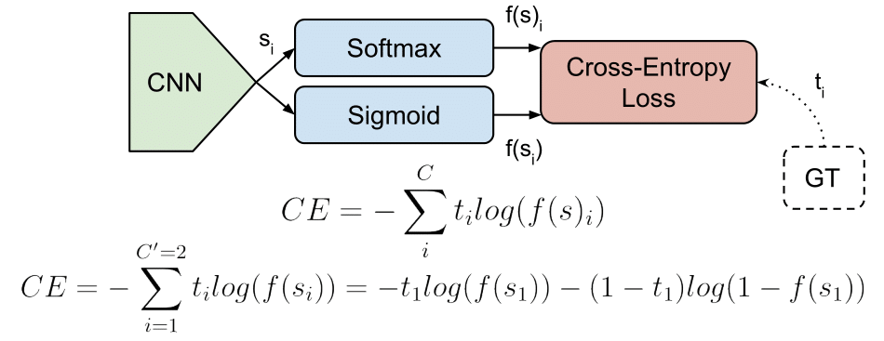
Loss function
For classification problems, we should choose a loss function that penalizes mislabeling
A common choice of L for classification problems is the categorical cross entropy function, a difference in cross entropies
Where s is the predicted label and t is the true label

Slide 30
Loss function
The loss function for a classification task is typically a function in the difference between actual label and predicted label
In a binary classification task (always classify as one of two classes), we typically choose the labels as 0 for class zero and 1 for class 1
If we have 10 classes, should we then choose the labels as 0, 1, 2, 3…,9 for classes zero to nine?

Slide 31
Loss function
If we have 10 classes, should we then choose the labels as 0, 1, 2, 3…,9 for classes zero to nine?
No. If the loss is a function of the difference of labels then there is a bigger difference between some classes than others here. For example, class 1 and class 9 than between class 1 and class 0. This will bias the machine to incorrectly misclassify class zero as class 1 over misclassifying it as class 9. If the classes are not in fact related this way then this bias will hurt our results.
Instead, use one hot encoding for the labels

Slide 32




Loss function
One hot encoding: for n labels 1 to N
Make the ith label $e_{i}$, the ith column of NxN identity matrix
Then make the loss function a function of the Euclidean distances between actual and predicted labels. Then all class differences are equal
$$y=1→y=\left[\begin{matrix}1 \\ 0 \\ \begin{matrix}0 \\ 0 \\ \begin{matrix}0 \\ 0 \\ \begin{matrix}0 \\ 0 \\ \begin{matrix}0 \\ 0\end{matrix}\end{matrix}\end{matrix}\end{matrix}\end{matrix}\right]$$
$$y=2→y=\left[\begin{matrix}0 \\ 1 \\ \begin{matrix}0 \\ 0 \\ \begin{matrix}0 \\ 0 \\ \begin{matrix}0 \\ 0 \\ \begin{matrix}0 \\ 0\end{matrix}\end{matrix}\end{matrix}\end{matrix}\end{matrix}\right]$$
$$y=10→y=\left[\begin{matrix}0 \\ 0 \\ \begin{matrix}0 \\ 0 \\ \begin{matrix}0 \\ 0 \\ \begin{matrix}0 \\ 0 \\ \begin{matrix}0 \\ 1\end{matrix}\end{matrix}\end{matrix}\end{matrix}\end{matrix}\right]$$
…

Slide 33
Loss function
Define an epoch as the process of taking one descent step and updating (w,b) one time and an iteration as one collection of epochs
Since we update through an iterative process, we also need to choose the parameters of the iteration:
Learning rate – the amount by which to update (w,b) on each iteration
Learning rate decay – the amount by which to change the learning rate on iterations
Batch size – the number of datapoints used in calculation in each iteration
Number of epochs – the number of iterations over which (w,b) are solved for iteratively
Max number of iterations – maximum number of descent steps taken in an epoch

Slide 34
Recurrent Neural Networks
What if the inputs to our neural network come from time series data like a time dependent signal
x[0]
x[n]
…
x[N-2]
x[N-1]

Slide 35
Recurrent Neural Networks
There may be some time dependent relationship between the samples, but our current model doesn’t have any way to learn parameters across a temporal dimension of the signal
x[0]
x[n]
…
x[N-2]
x[N-1]

Slide 36
Recurrent Neural Networks
And so we can add parameters between nodes in the same layer to learn temporal relationships in the input. We call these recurrent connections.

Slide 37
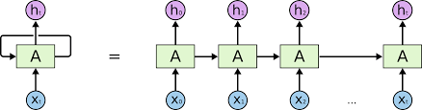
Recurrent Neural Networks
A network with recurrent connections is called a recurrent neural network (RNN)
This structure eliminates the need for every node in the previous layer to be connected to every node in the following layer, and so we may remove some or all of those connections

Slide 38
Recurrent Neural Networks
Since they are calculated over the time axis, parameters of the recurrent connections in a recurrent network must be calculated sequentially (one at a time). They cannot be done in parallel. This will increase the training time
Calculate this parameter
Before you calculate this one

Slide 39
Recurrent Neural Networks
This means that the value of the parameters can change based on the order in which you calculate them
To cover our bases, we could calculate both a set of parameters starting at x[0] going x[N-1] and a set of parameters going from x[N-1] to x[0]

Slide 40
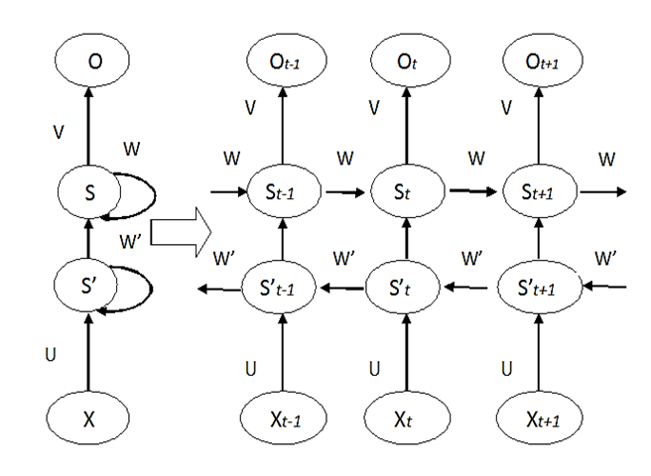
Recurrent Neural Networks
This is called a bidirectional RNN

Slide 41
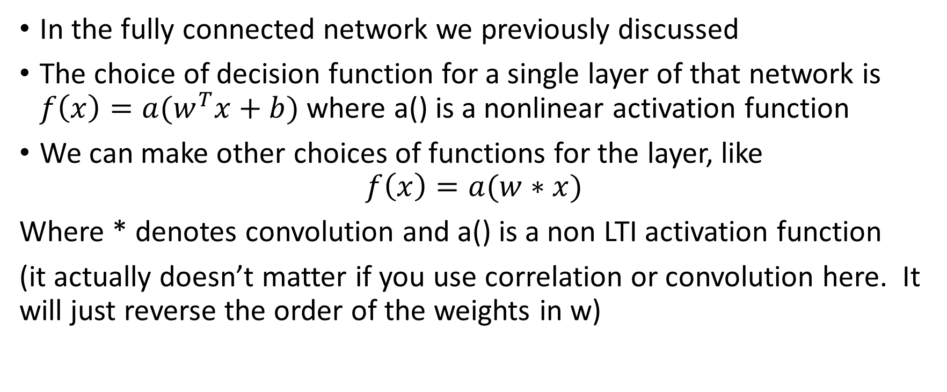
Convolutional Neural Network
In the fully connected network we previously discussed
The choice of decision function for a single layer of that network is $f\left(x\right)={a(w}^{T}x+b)$ where a() is a nonlinear activation function
We can make other choices of functions for the layer, like
$$f\left(x\right)=a(w∗x)$$
Where * denotes convolution and a() is a non LTI activation function
(it actually doesn’t matter if you use correlation or convolution here. It will just reverse the order of the weights in w)

Slide 42
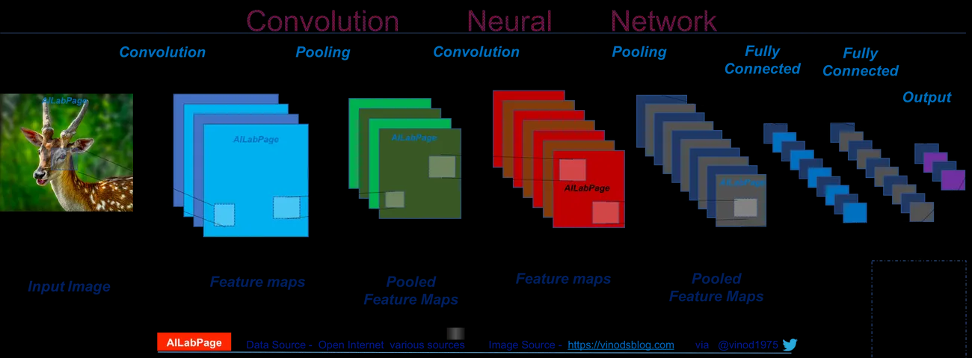
Convolutional Neural Network
Although we’ve only done 1D convolution, we can do 2D or higher convolution also.
For the nonlinear activation function, we typically choose upsampling or downsampling as our non LTI activation function

Slide 43
Convolutional Neural Network
For classification, we typically alternate between convolving and down sampling (pooling) until we get an output that can easily be feed into a fully connected neural network.
This output contains information about the spatial relationship of the inputs

